Slide 1
CERTIFICATE VALIDATION USING BLOCKCHAIN ETHVALIDIFY
PIP104 PROFESSIONAL PRACTICE-II
VIVA-VOCE
Batch Number: CSE-G133
Under the Supervision of,
Ms. Naiwrita Borah
Assistant Professor
School of Computer Science and Engineering
Presidency University
Roll Number
20201CSE0697
20201CSE0682
20201CSE0683
Student Name
Nandeesh Gowda C
Hruthik S
Sudarsh V

Slide 2
Introduction
This project involves the design and development of a blockchain-based certificate validation system using smart contracts and distributed ledger technology.
The system will enable academic institutions to issue digital certificates as unique, tamper-proof records stored on the blockchain.
Through consensus mechanisms, the integrity and authenticity of certificates can be verified by relevant stakeholders, including potential employers, academic institutions, and certificate holders.

Slide 3
Literature Review
Yao et al. made a model for solving certificate authentication problems. This proposal focused on providing proper data security.
Cheng et al. and Zhao et al. develop smart contracts for digital certificates. This project focused on solving the problem of counterfeiting certificates.
Verification and Validation of Certificates Using Blockchain-Rohan and the team computer Dept, in Pune have defined the working of the certificate validation using Blockchain.

Slide 4
Research Gaps Identified
A critical gap lies in the exploration of regulatory and legal frameworks governing blockchain-based certificate validation(Beck et al., 2018; Azaria et al., 2016).
Many studies acknowledge the need for further research on addressing scalability challenges and enhancing the overall performance of blockchain networks (Bano et al., 2017; Zohar, 2015).
Limited attention has been given to understanding user perceptions and the overall user experience in interacting with blockchain-based certificate validation systems(Kshetri, 2018; Al-Bassam et al., 2018).

Slide 5
Proposed Methodology
System Architecture and Smart Contract Development : Design a decentralized system architecture, specifying the roles of participants and interactions within the blockchain network.
Blockchain Platform Selection and Integration : Evaluate and select a suitable blockchain platform based on the specific requirements.
User-Centric Interface and Testing : Develop a user-friendly interface for stakeholders, emphasizing simplicity and accessibility.

Slide 6
Objectives
To develop a blockchain-based system that ensures secure storage and verification of certificates and credentials.
To implement smart contracts to automate the certificate validation process and enforce validation rules transparently.
To explore various blockchain platforms and identify the most suitable one for building the certificate validation system.
To deliver a prototype of the certificate validation system that enhances security, transparency, and reliability in credential verification processes across industries.

Slide 7
System Design & Implementation
Blockchain Network Configuration : Establish a decentralized blockchain network, to provide a secure and transparent environment for certificate validation.
Smart Contract Development : Design and implement smart contracts defining the rules for certificate issuance and validation.
User Interface Development and Interoperability : Create user-friendly interfaces for certificate stakeholders.

Slide 8
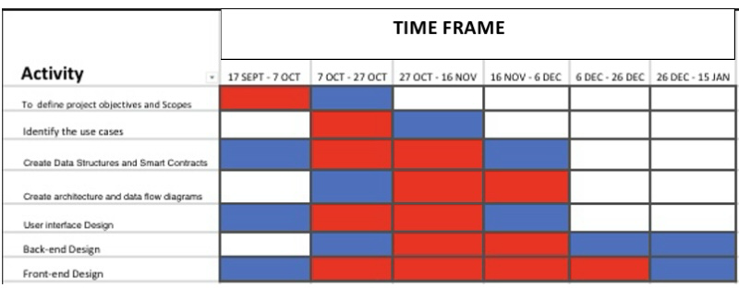
Timeline of Project

Slide 9
Outcomes / Results Obtained
One of the key outcomes of implementing blockchain-based certificate validation is the significant enhancement of trust and integrity in the verification process.
Blockchain technology facilitates automated and efficient validation processes through smart contracts, reducing reliance on centralized authorities.
The adoption of blockchain for certificate validation allows for global accessibility and interoperability, enabling seamless verification of credentials .

Slide 10
Conclusion
In conclusion, blockchain-based certificate validation offers security and transparency, mitigating the risks associated with frauds.
The adoption of blockchain technology for certificate validation not only streamlines the verification process but also fosters increased efficiency and trust among stakeholders.
The integration of blockchain in certificate validation has the potential to disrupt traditional validation systems, offering a decentralized, user-centric approach that could revolutionize the way academic and professional credentials are verified globally.

Slide 11
References
S. Yao, J. Chen, K. He, R. Du, T. Zhu and X. Chen, "PBCert: Privacy-Preserving Blockchain-Based Certificate Status Validation Toward Mass Storage Management," in IEEE Access, vol. 7, pp. 6117-6128, 2019, doi: 10.1109/ACCESS.2018.2889898.
J. Cheng, N. Lee, C. Chi, and Y. Chen, "Blockchain and smart contract for digital certificate," 2018 IEEE International Conference on Applied System Invention (ICASI), Chiba, 2018, pp. 1046-1051, doi: 10.1109/ICASI.2018.8394455.
Rohan Hargude, Ghule Ashutosh, Abhijit Nawale, Sharad Adsure,” Validation and verification of certificates using Blockchain”, 2021 IJCRT | Volume 9, Issue 6 June 2021 | ISSN: 2320-2882.

Slide 12
Publication Details
Paper Title : A Decentralized Approach to trust : Blockchain for Certificate Validation
Authors :Nandeesh Gowda C - nandeeshg993@gmail.com
Hruthik S – learningbeyondscience@gmail.com
Sudarsh V – sudarshavdn@gmail.com
Published Website Link : https://www.ijsrd.com/
Published Date : 12 January 2024

Slide 13

Thank You
Github Link : https://github.com/hruthiks6/ethvalidify

